Slide 1
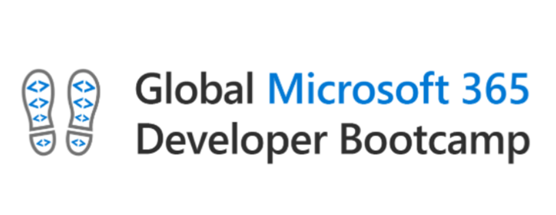
Singapore 2020

Slide 2


SharePoint SPFx DevOps using Azure Multi Stage Pipelines
Rifaj Aboobacker
Solutions Architect, Earth9.com
@rifaj /rifaj

Slide 3
Agenda
Why CI/CD
Azure DevOps Multi Stage Pipelines
Demo
Q&A

Slide 4
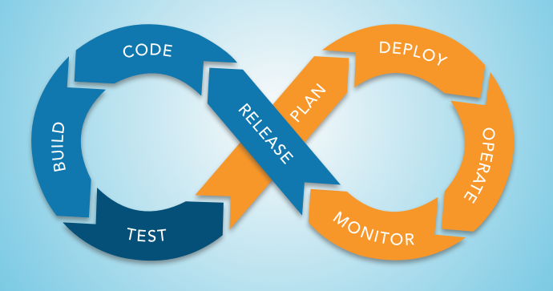

Slide 5
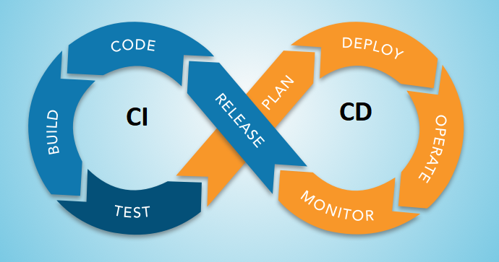

Slide 6
Continuous Integration
Helps developers integrate code into a shared repository
Automatically verifying the build using unit tests
Packaging the solution each time new code changes are submitted.
Notes:
If the development team is following Git Flow workflow, Automating the build, Pull requests/merge requests to protected branches Enforcing code analysis, linting, quality and coding standards
If a coding standard for a company, can be automatically enforced in the company The tech lead/code reviewer can focus on Business logic and architecture related reviews rather than checking for the spelling mistakes or if the code follows the standards Enforcing unit tests, code coverage

Slide 7
Continuous Delivery
Continuous Deployment (CD) takes validated code packages from build process and deploys them into a staging or production environment.
Developers can track which deployments are successful and narrow down issues to specific package versions.
Notes:
Automating the packaging, version numbering/manifests, multiple QA environments etc Integration tests

Slide 8
Benefits
Automate tedious tasks
Help developers stay focused
Reduce regression testing effort
Effortless product updates
More effective feedback loop
Detect and fix issues early
Enforce code quality and standards

Slide 9
Other benefits
Accelerate innovation and go-to-market
Code in the production is making money instead of sitting in a queue waiting to be deployed
Great ability to attract and retain talent
Higher quality code and operations due to specialization

Slide 10
CI / CD for SPFx
Maintaining the SPFx solutions for their integrity as they grow is challenging
Continuous manual build, test and deployment of the latest released package is a huge task
SharePoint Framework builds, unit tests, and deployments can be automated

Slide 11
CI/CD using Azure DevOps for SPFx
Azure Build and Release
Azure Multi-stage Pipeline

Slide 12
Azure Build and Release

Slide 13
Prerequisites – Azure Build & Release
Node.js v10.x. - https://nodejs.org/en/
Visual Studio Code
Yeoman and Gulp - npm install -g yo gulp
Yeoman SharePoint generator - npm install -g @microsoft/generator-SharePoint
Azure DevOps account - https://dev.azure.com/
Git
Setup App catalog site – Optional

Slide 14
Steps
Create a new pipeline
Install NodeJS
Restore dependencies
Execute Unit Tests
Import test results
Import code coverage information
Bundle the solution
Package the solution
Prepare the artifacts
Publish the artifacts

Slide 15
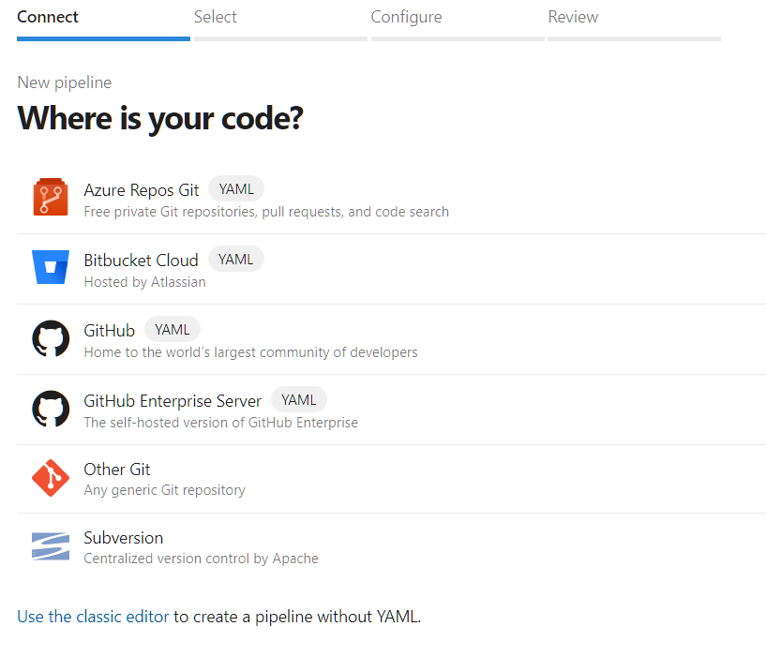
Creating a new pipeline

Slide 16
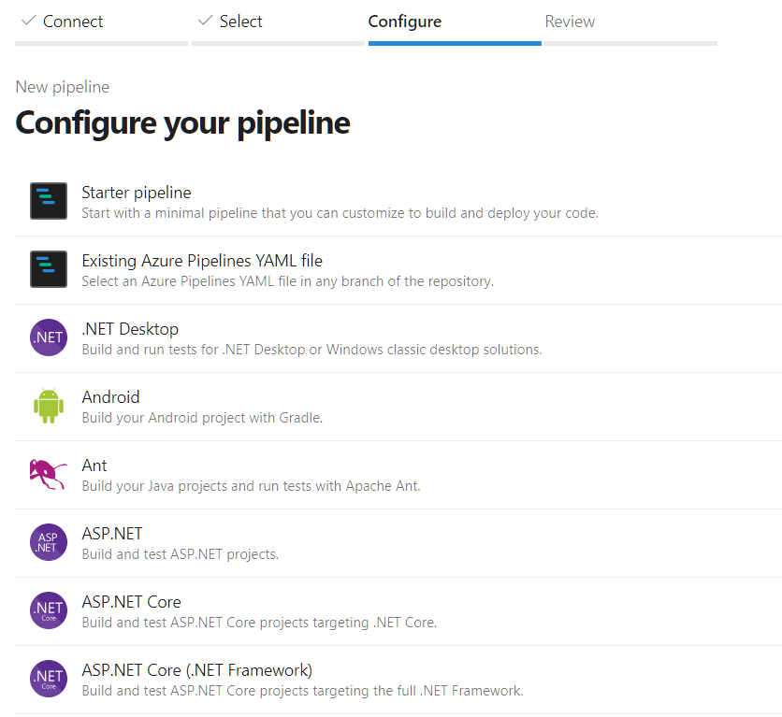

Slide 17
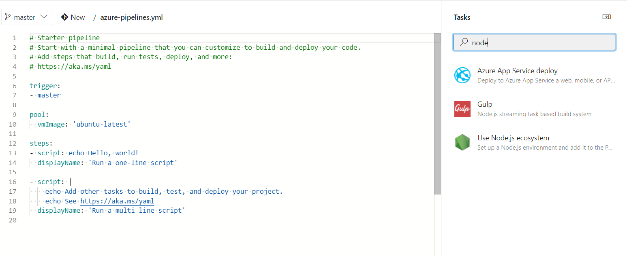

Slide 18
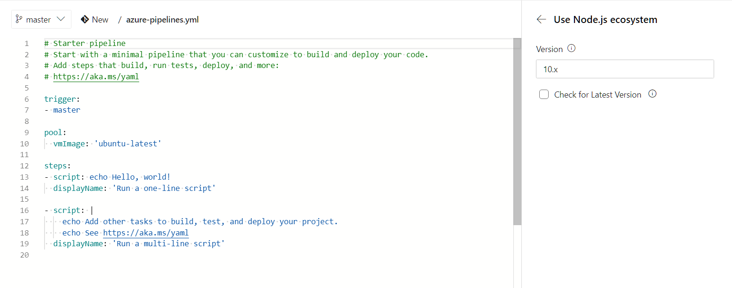

Slide 19
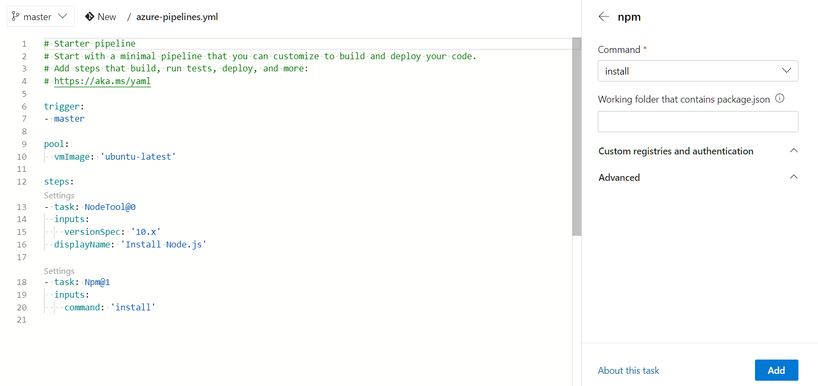
Restoring dependencies

Slide 20
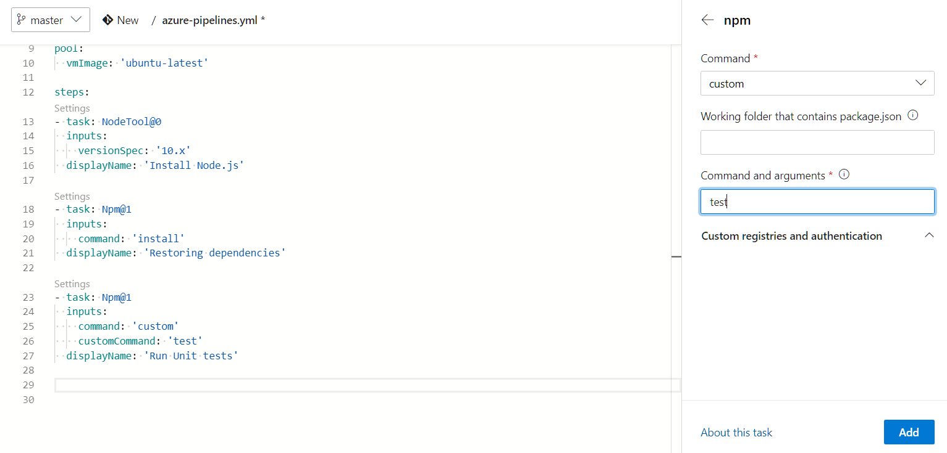
Executing Unit Tests

Slide 21
Configuring Jest
By default SharePoint Framework projects do not include a testing Framework.
We will use Jest as testing framework
npm i jest jest-junit @voitanos/jest-preset-spfx-react16 -D

Slide 22
Writing a unit test
Create a new file src/webparts/webPartName/tests/webPartName.spec.ts and add the tests
Run npm test to execute the unit tests

Slide 23
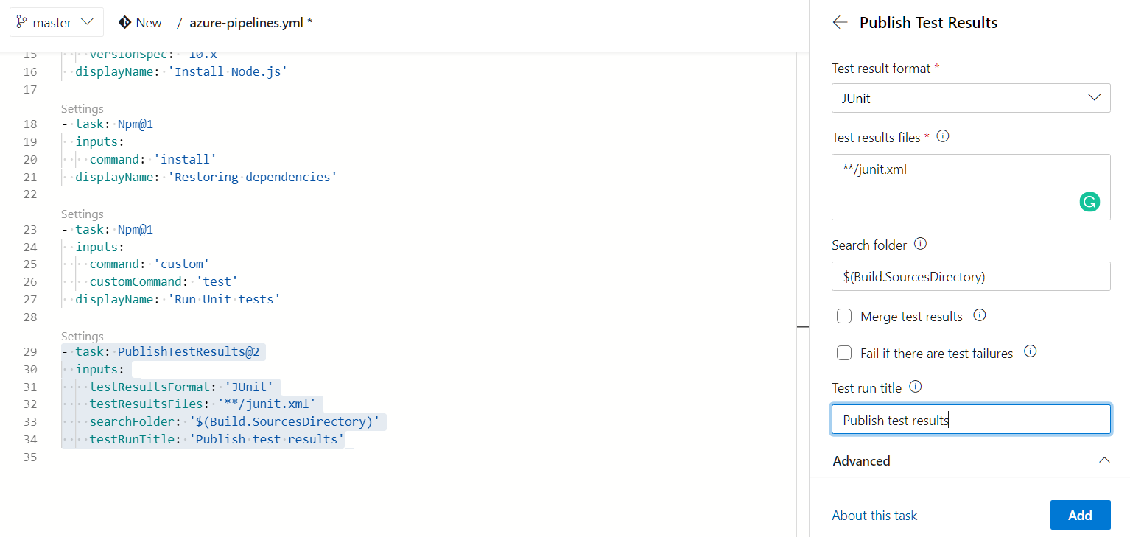
Importing test results

Slide 24
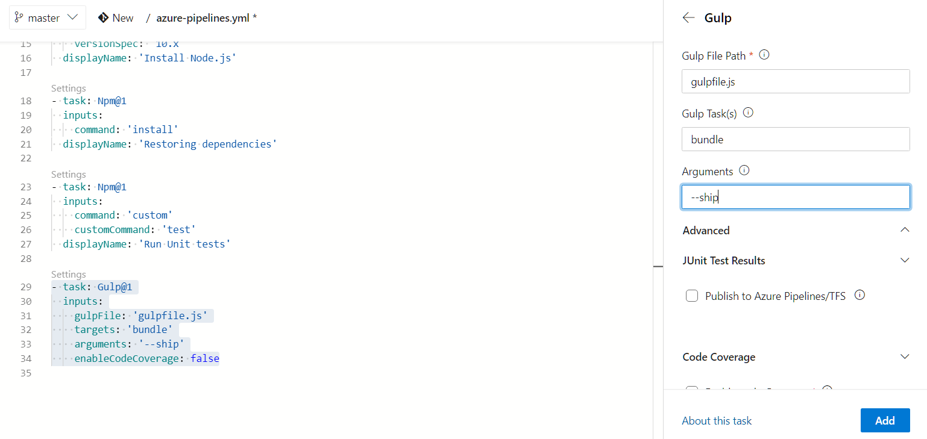
Bundling the solution

Slide 25
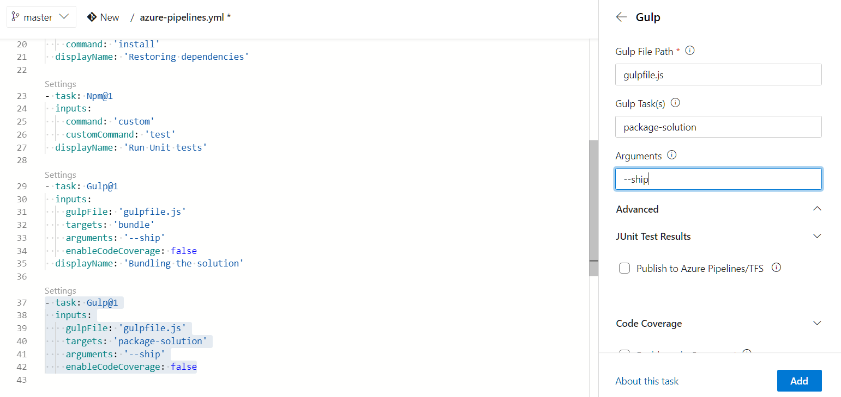
Packaging the solution

Slide 26
Preparing the artifacts
By default, an Azure DevOps build does not retain any files.
To ensure that the required files needed for the release are retained, we need to explicitly indicate what files should be kept.
Add a Copy Files task and set the Contents to **\*.sppkg (the SharePoint Package created with the previous task) and the target folder to $(build.artifactstagingdirectory)/drop.

Slide 27
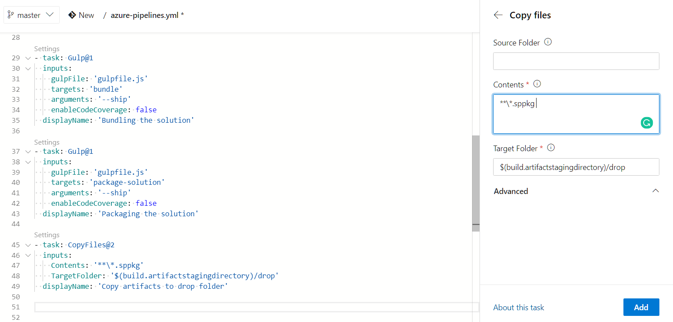

Slide 28
Publishing the artifacts
Now we have collected all the files needed for deployment in a special artifacts folder
We still need to instruct Azure DevOps to keep these files after the execution of the build

Slide 29
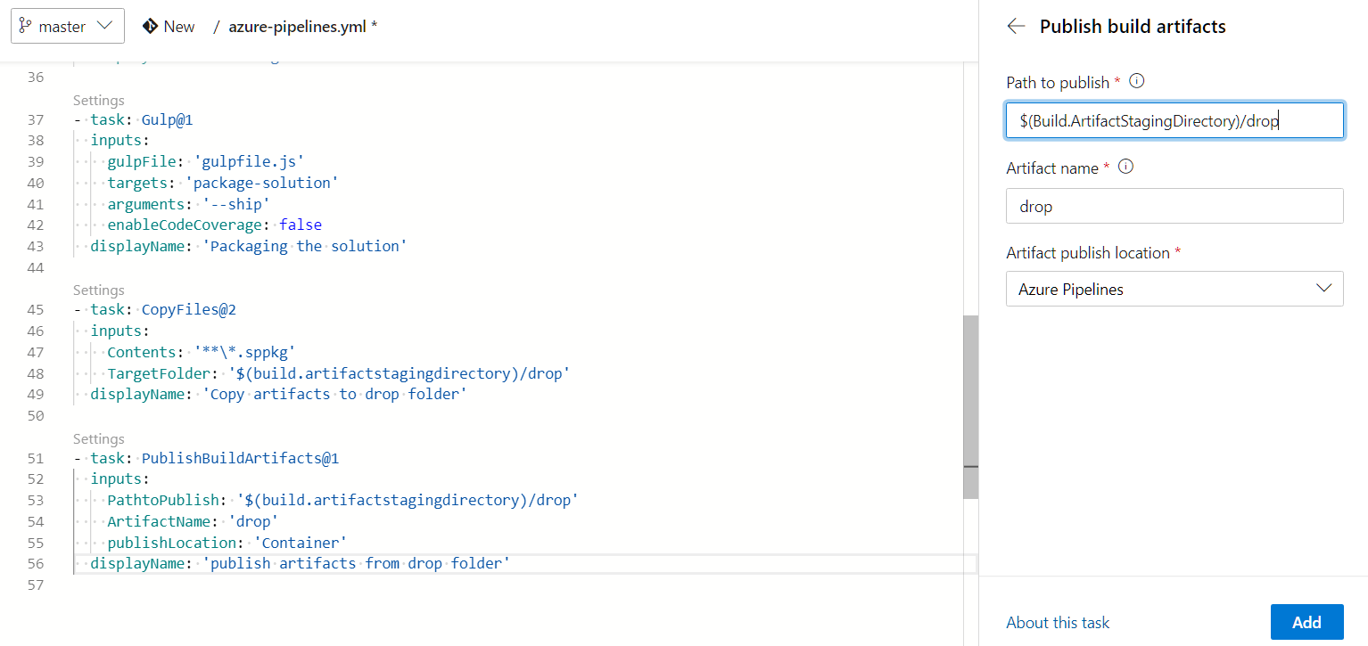

Slide 30
Continuous deployment

Slide 31
Steps
Create the Release Pipeline
Link the Build Artifact
Create the Environment
Install NodeJS
Install the Office 365 CLI
Connect to the App Catalog
Add the Solution Package to the App Catalog
Deploy the Application
Set the Variables for the Environment

Slide 32
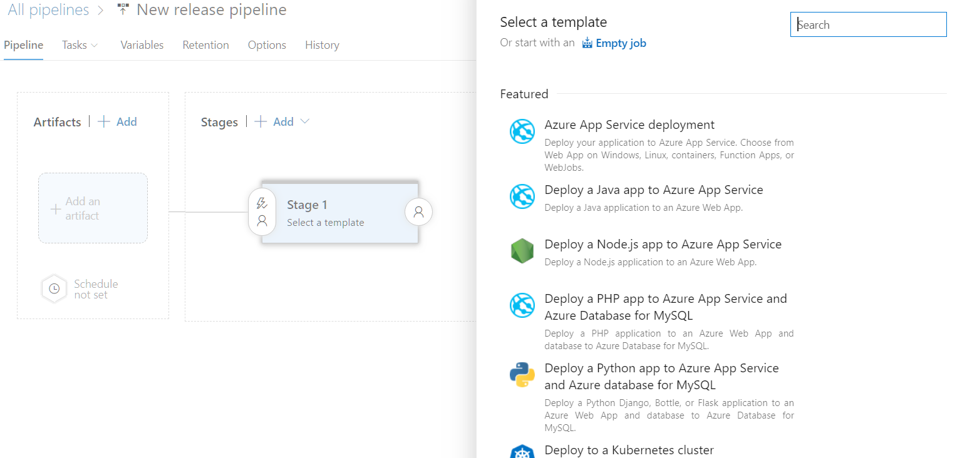
Release pipeline

Slide 33
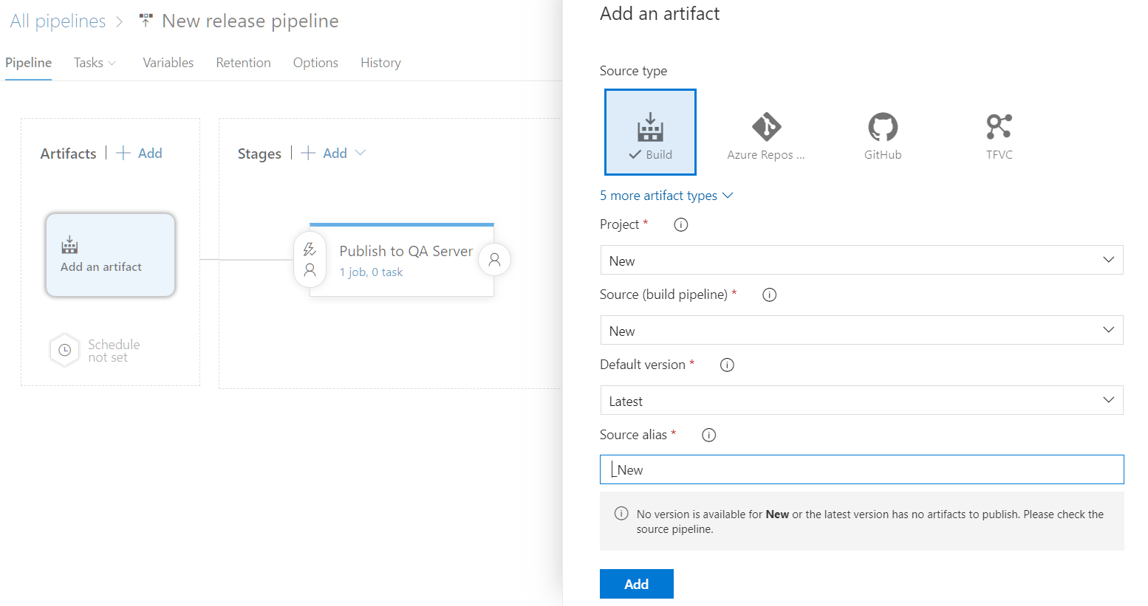
Linking the build artifacts

Slide 34
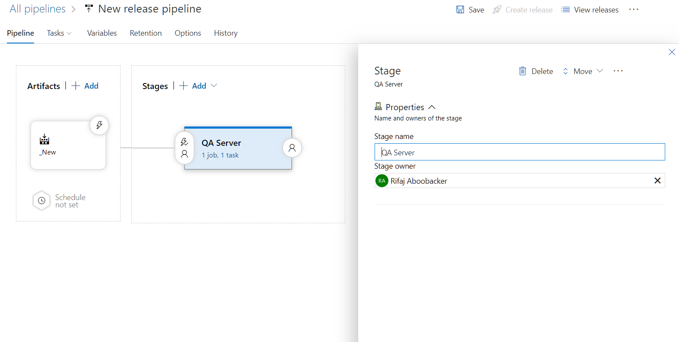
Creating the environment

Slide 35
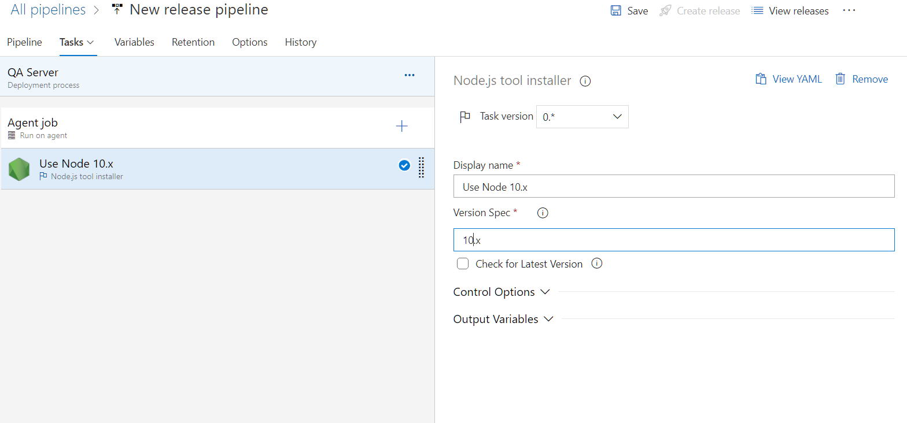
Installing node.js

Slide 36
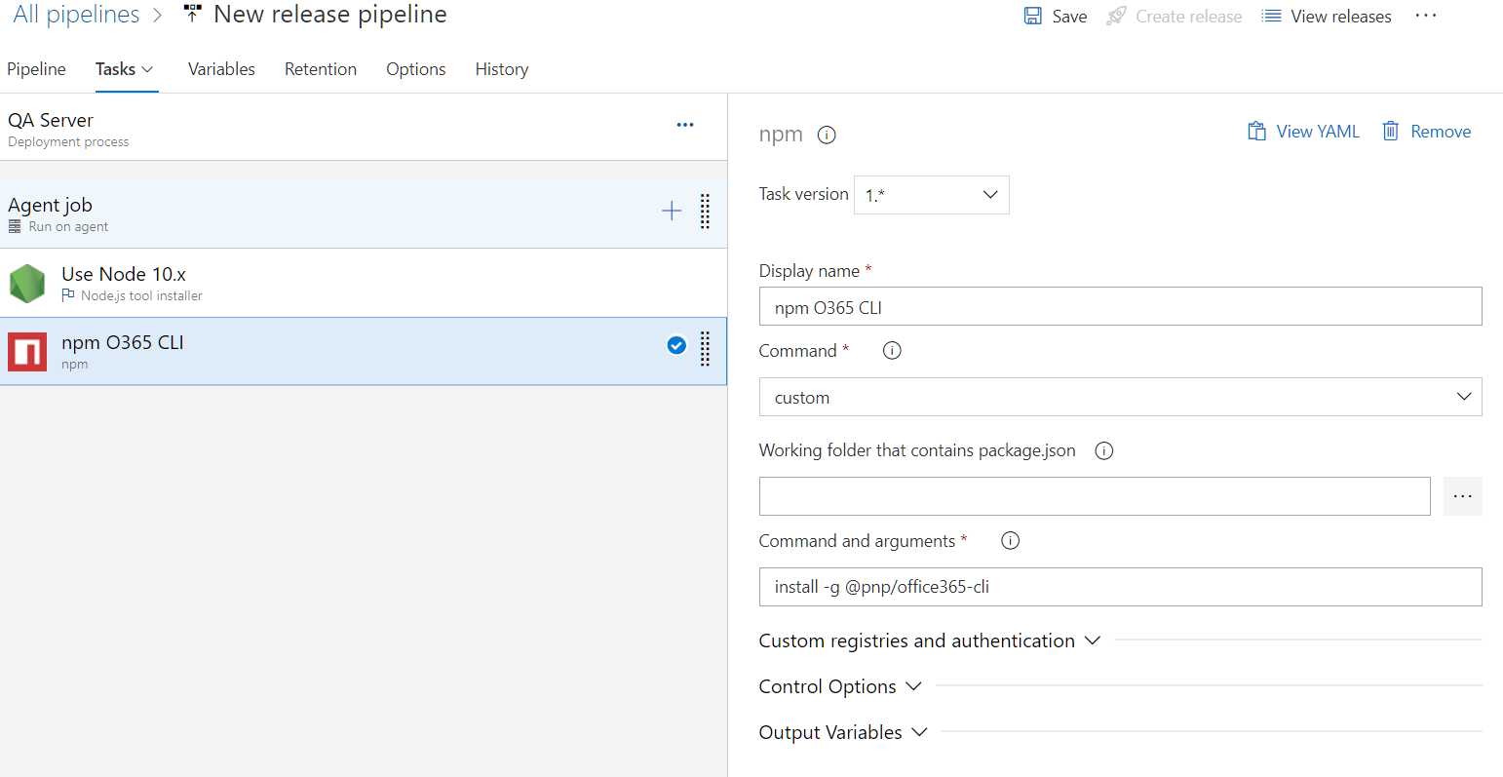
Installing O365 CLI

Slide 37
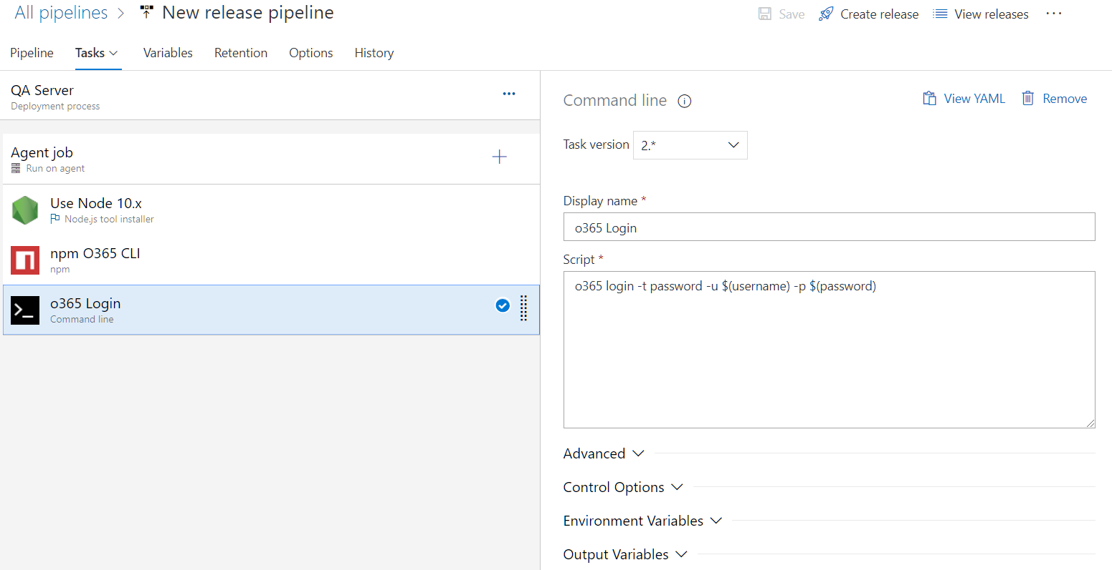
Connect to SPO

Slide 38
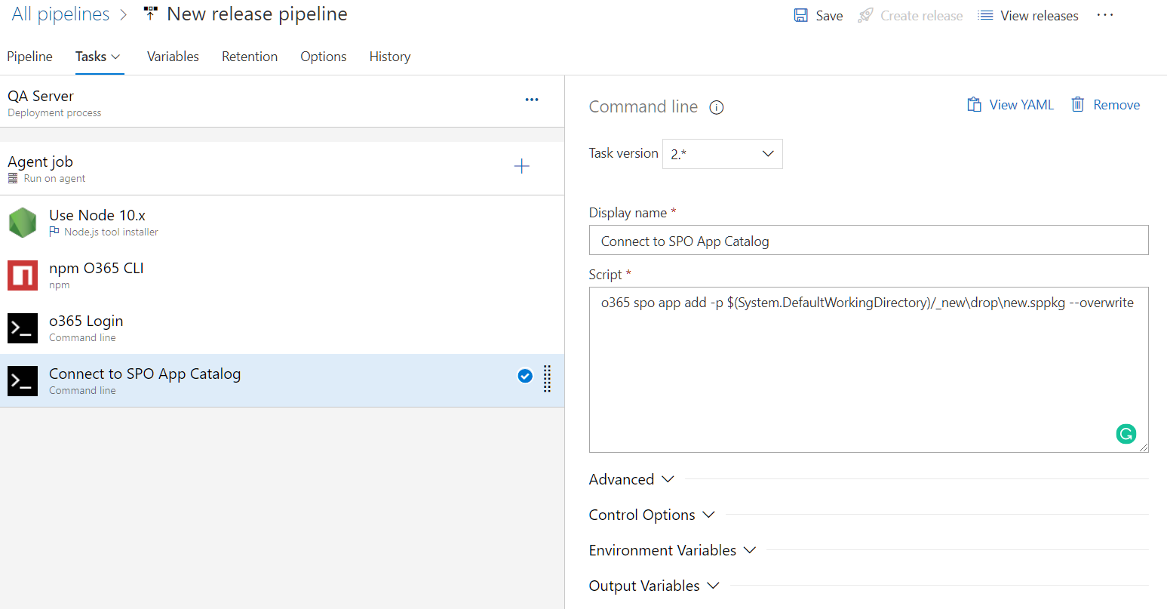
Add package to App Catalog

Slide 39
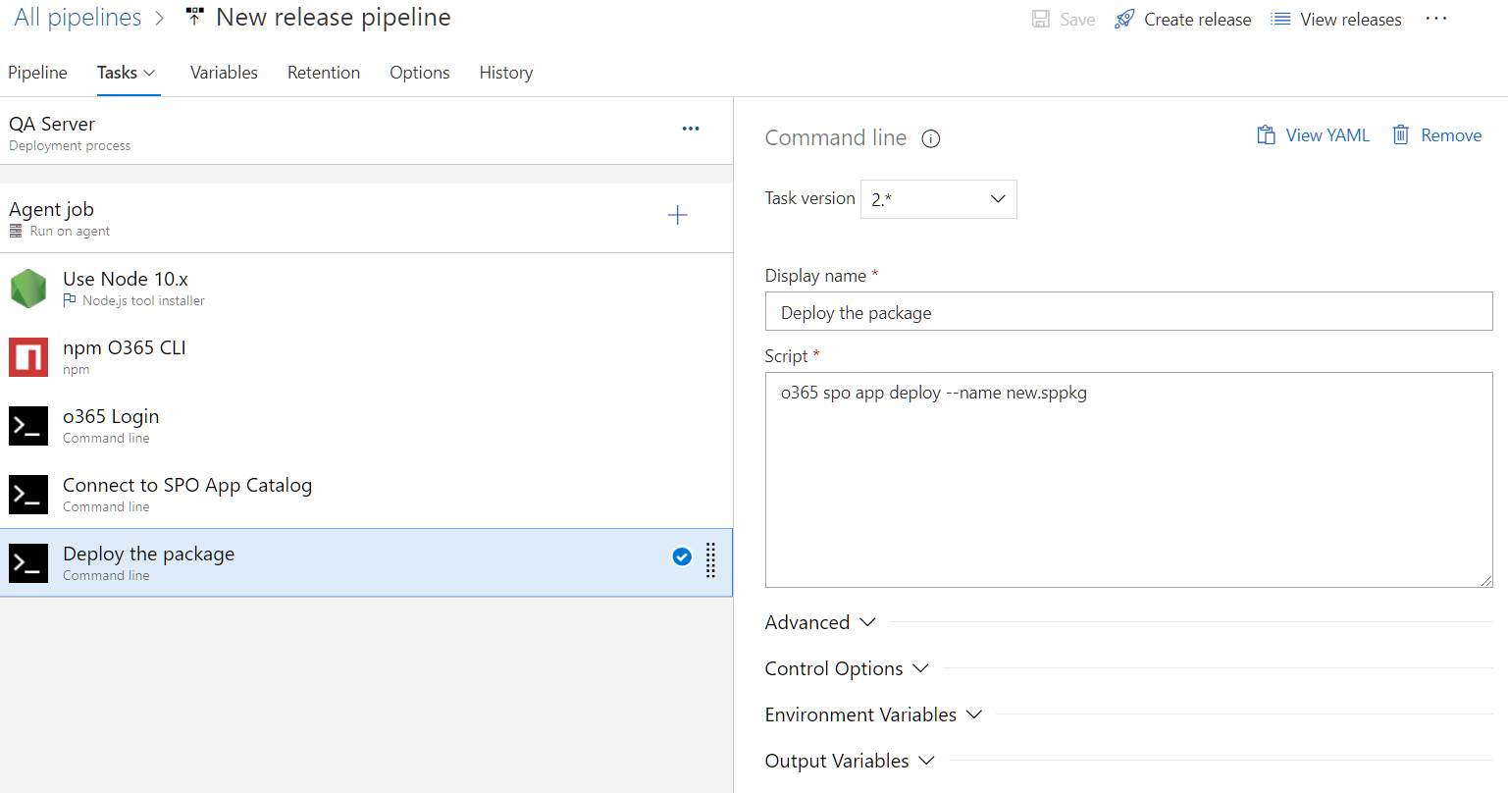
Deploying application

Slide 40
Azure Multi-Stage Pipelines

Slide 41
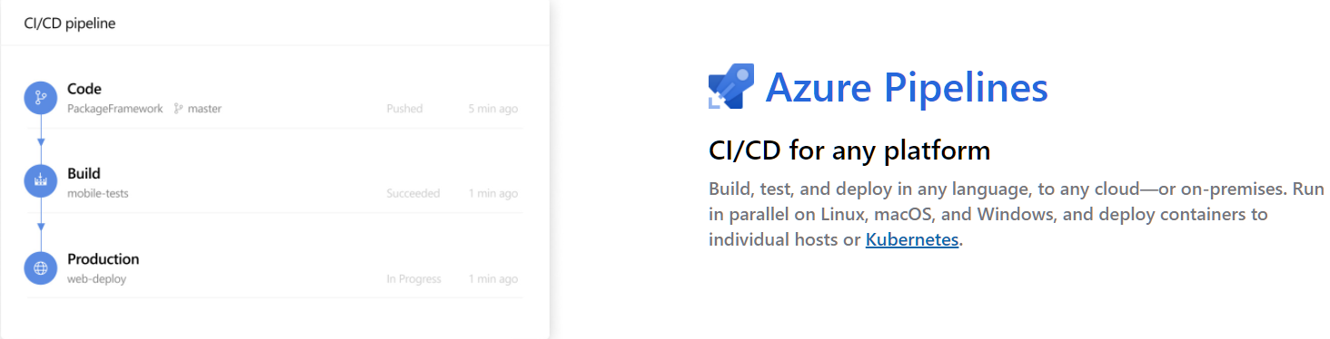

Slide 42
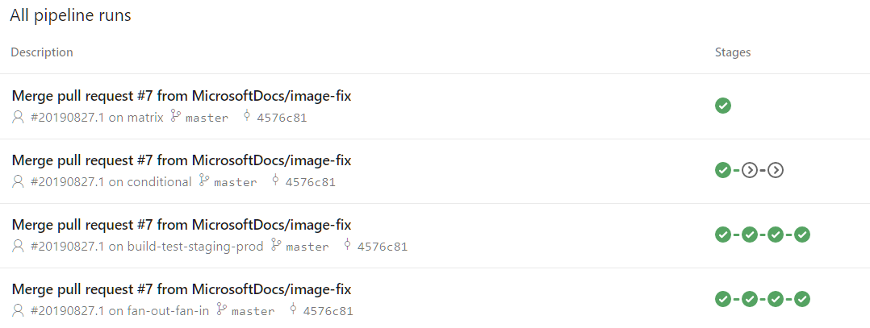

Slide 43
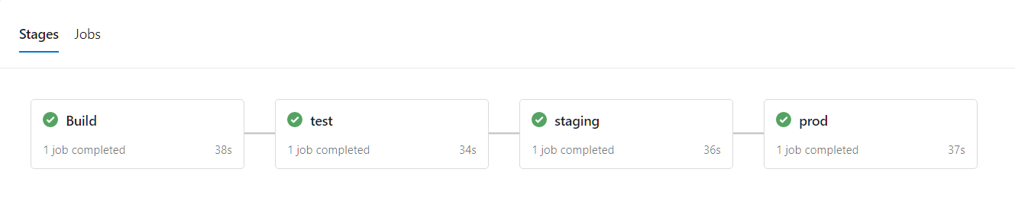

Slide 44
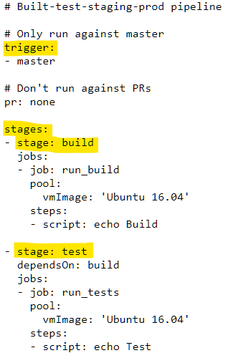
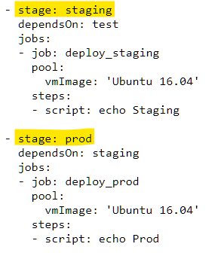

Slide 45
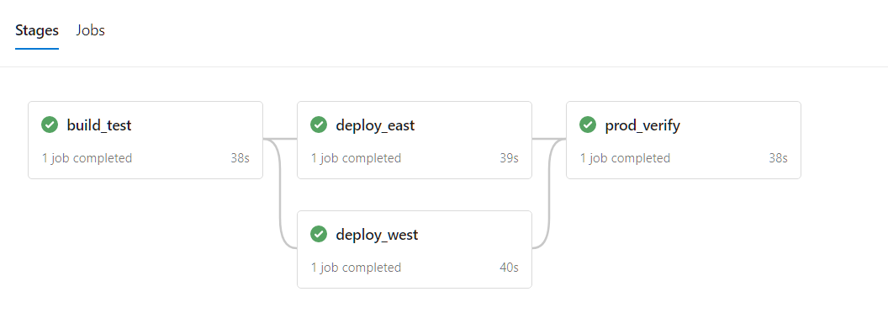
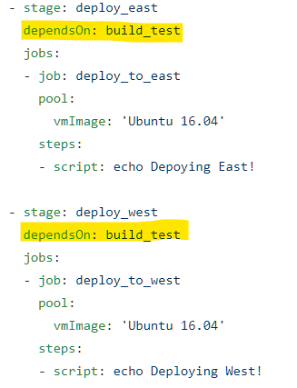
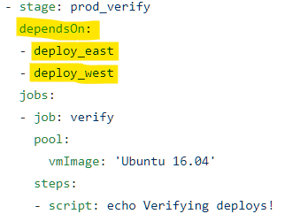

Slide 46
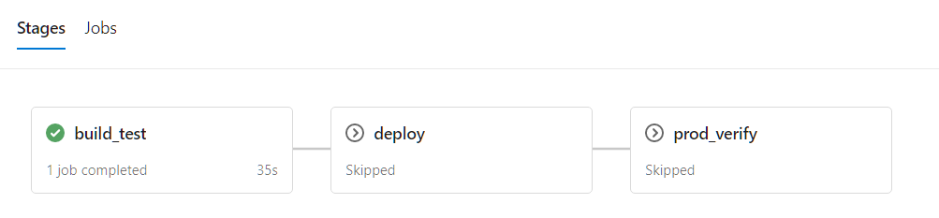
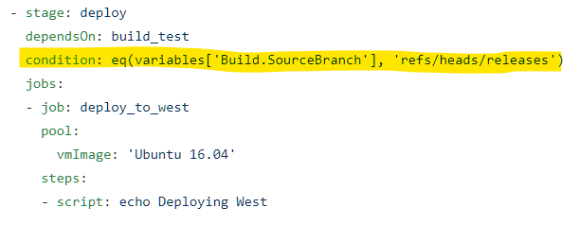

Slide 47
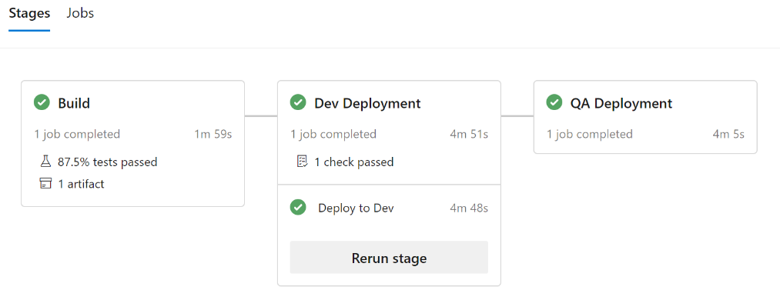

Slide 48
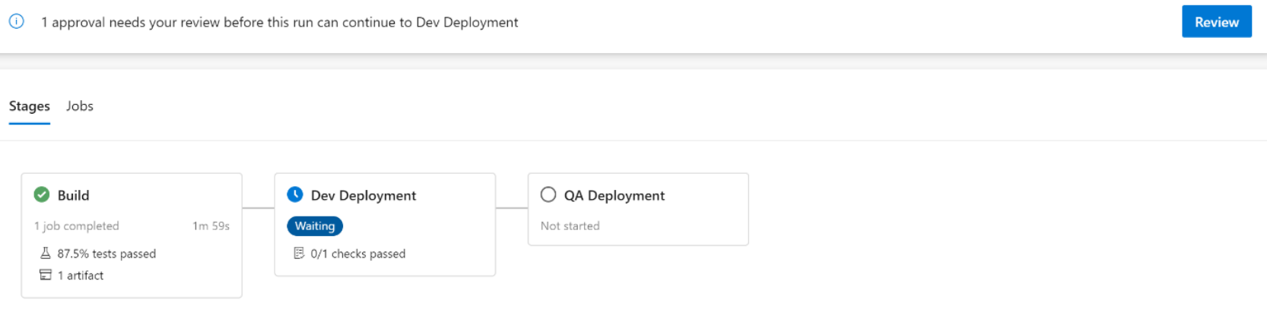
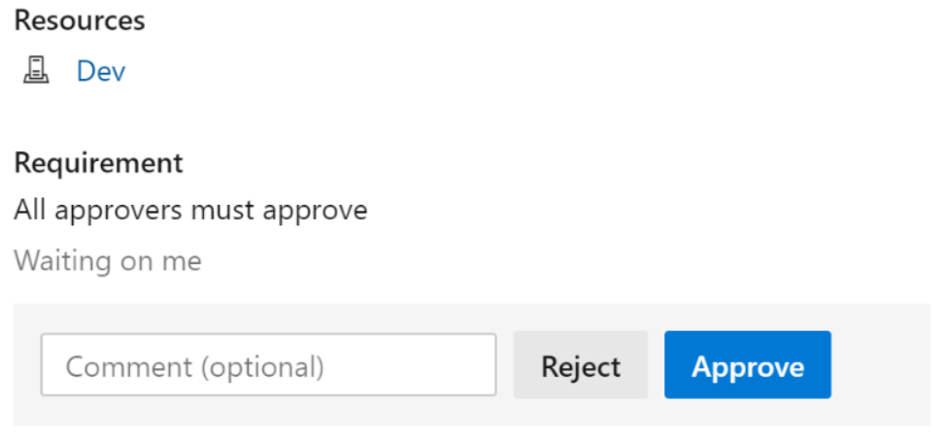

Slide 49
SPFx on Azure DevOps

Slide 50
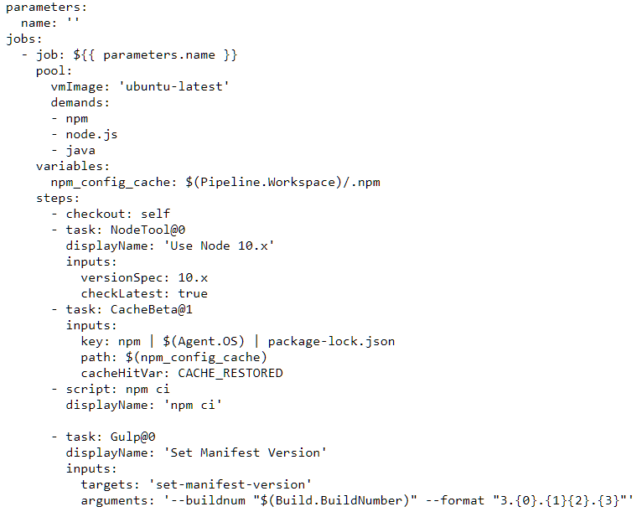
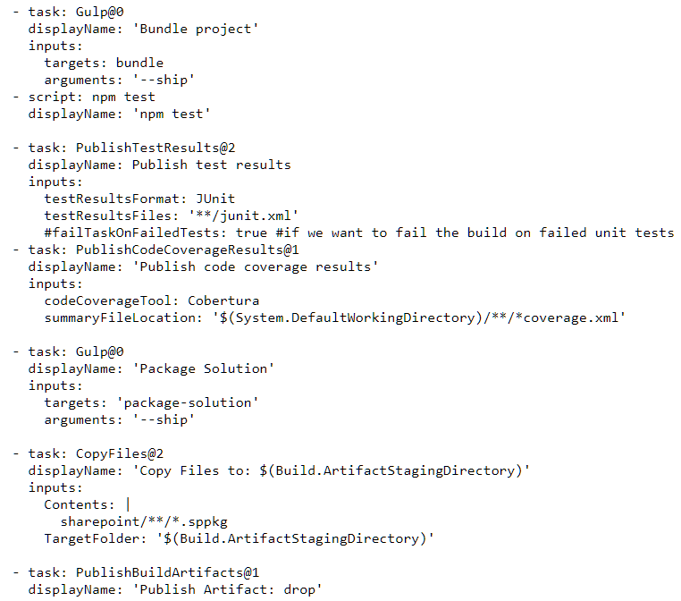
Implementing Continuous Integration and Continuous testing

Slide 51
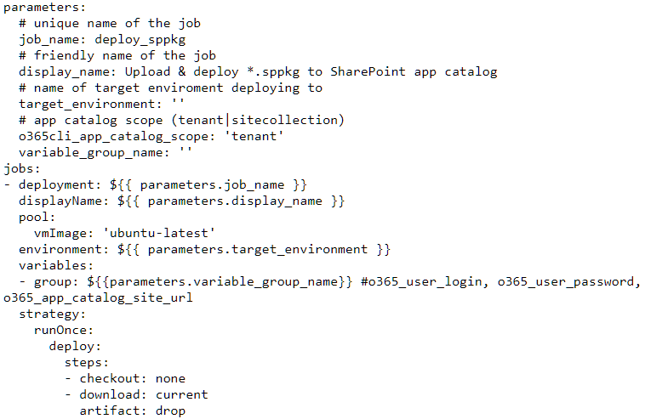
Implementing Continuous Deployment

Slide 52
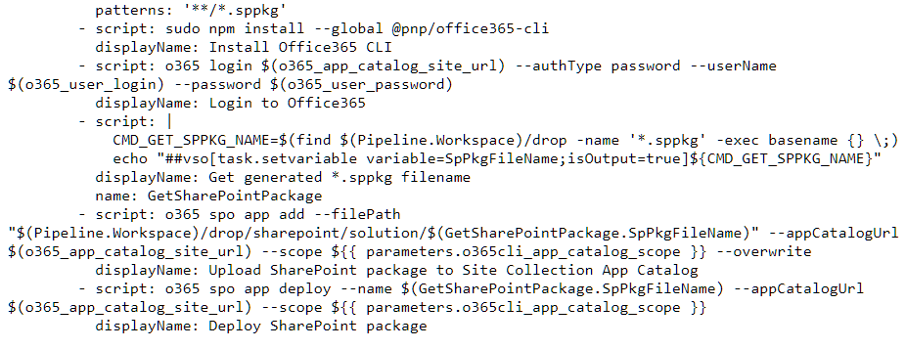

Slide 53
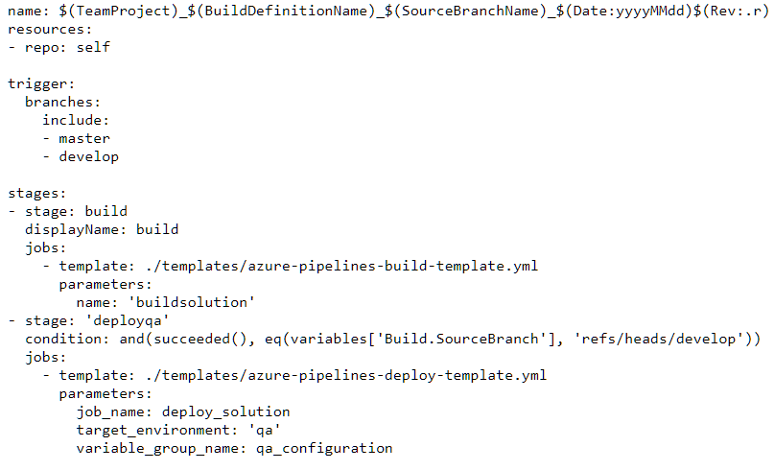
Defining Pipeline Structure

Slide 54
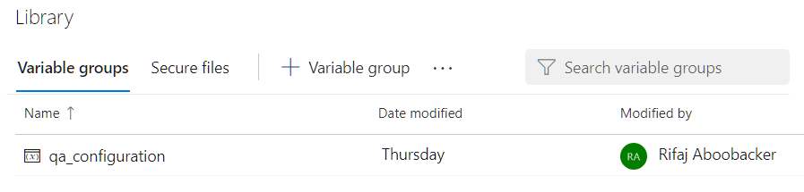
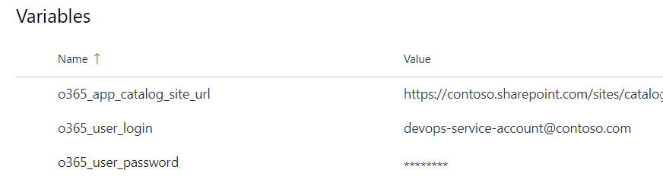

Slide 55
Q&A

Slide 56
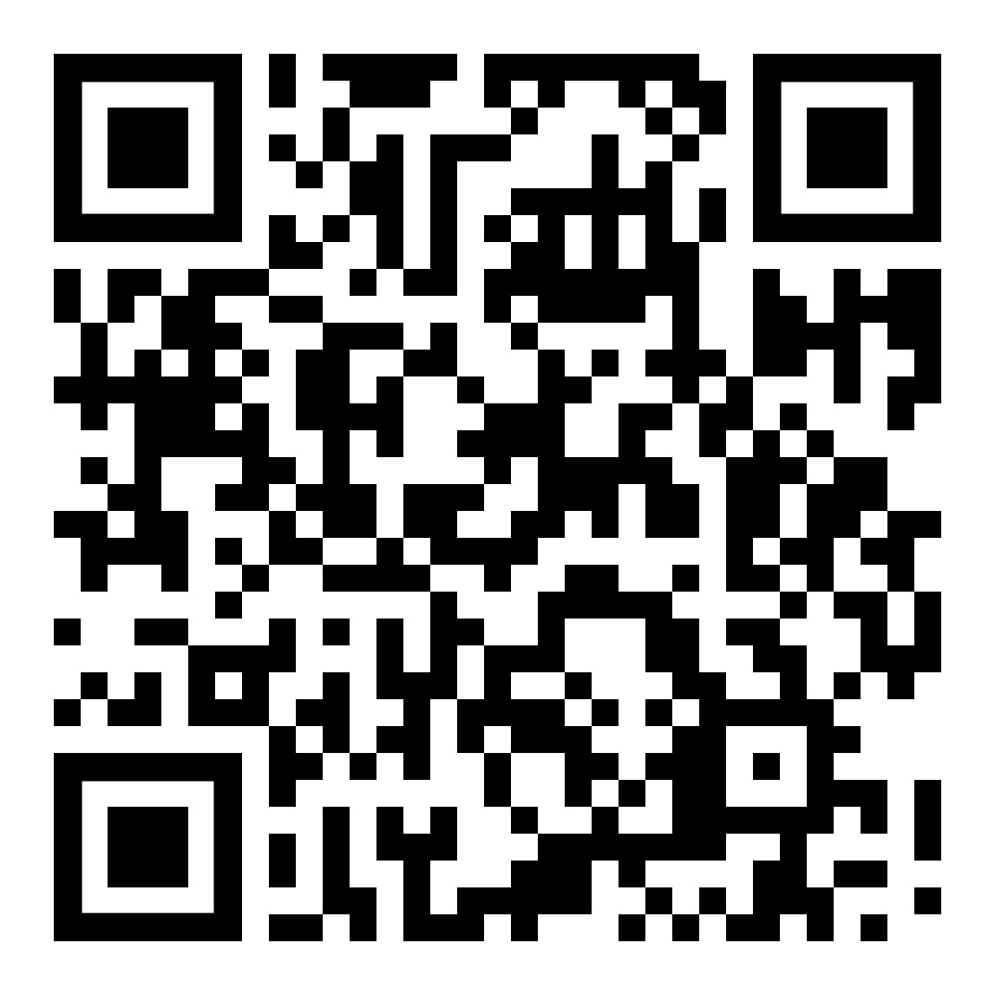
Feedback
https://aka.ms/Microsoft365DevBootcampSurvey2020

Slide 57
Thank you

